Slide 1
QUAERE Piloting Visit at Odessa National University

Slide 2
QUAERE Piloting Visit – Team

Slide 3
Transfer to the Administrative Building of Odessa I.I. Mechnikov National University.

Slide 4
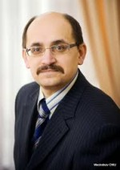
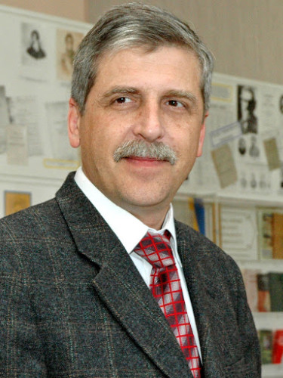
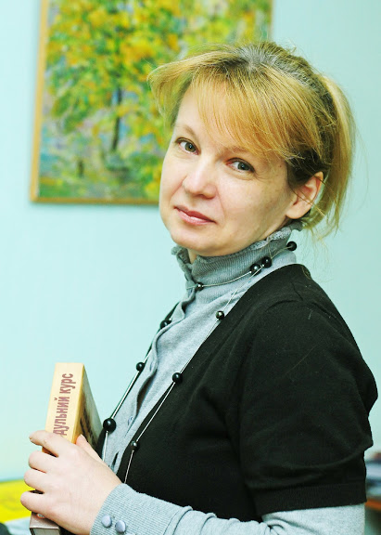
Meeting with HEI leadership – Vice-Rector prof. Khmarskii Vadym, Vice-Rector prof. Zaporozhchenko Alexandr and Head of the Quality Department of ONU – prof. Annienkova Irina.

Slide 5
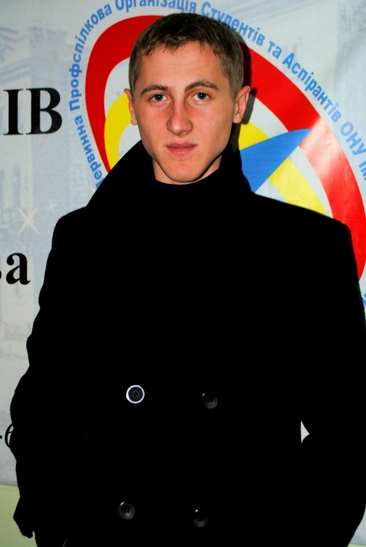
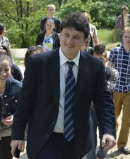
Meeting with the trade union of the University – TU leader Yurash Eugen, and Union of the Young Scientist of Odesa I.I. Mechnikov National University – Volodymyr Nemertsalov

Slide 6
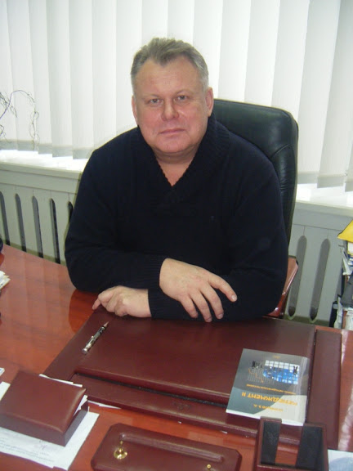
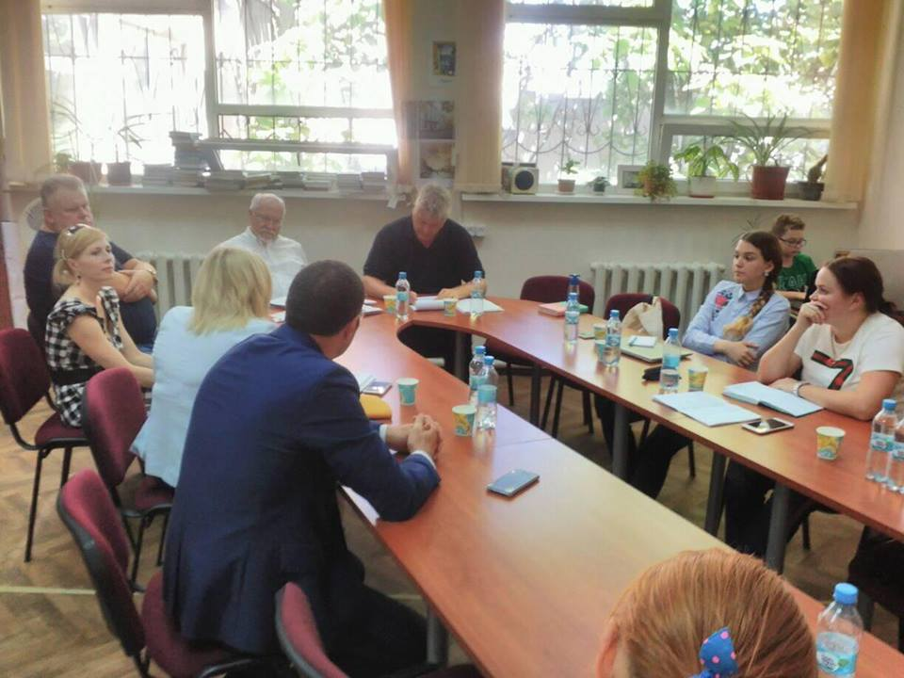
Meeting with academic programme management (programme directors, deans, etc.) and teaching staff. Department of Economics and Management, Odesa Mechnikov National University

Slide 7
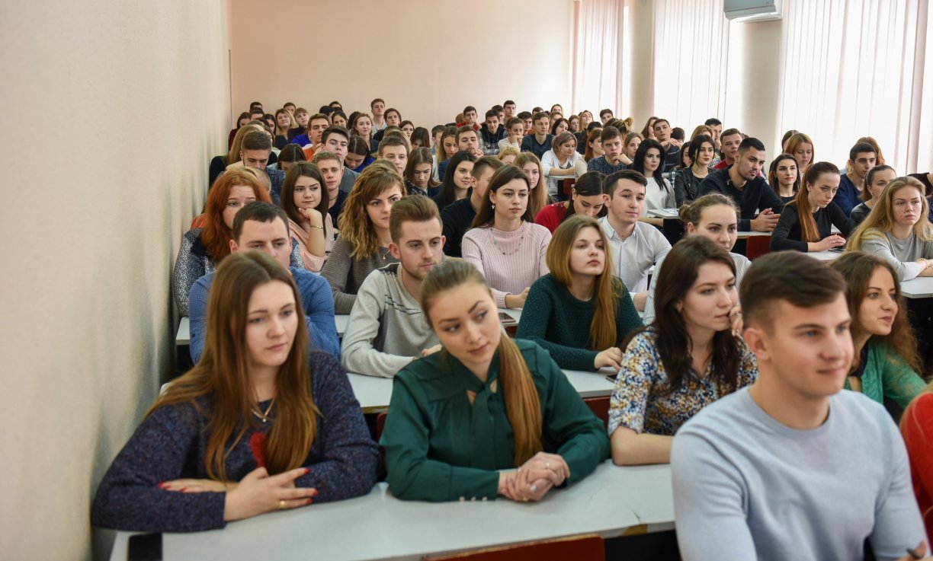
Meeting with students and Students Union
Closed for visiting ☺

Slide 8
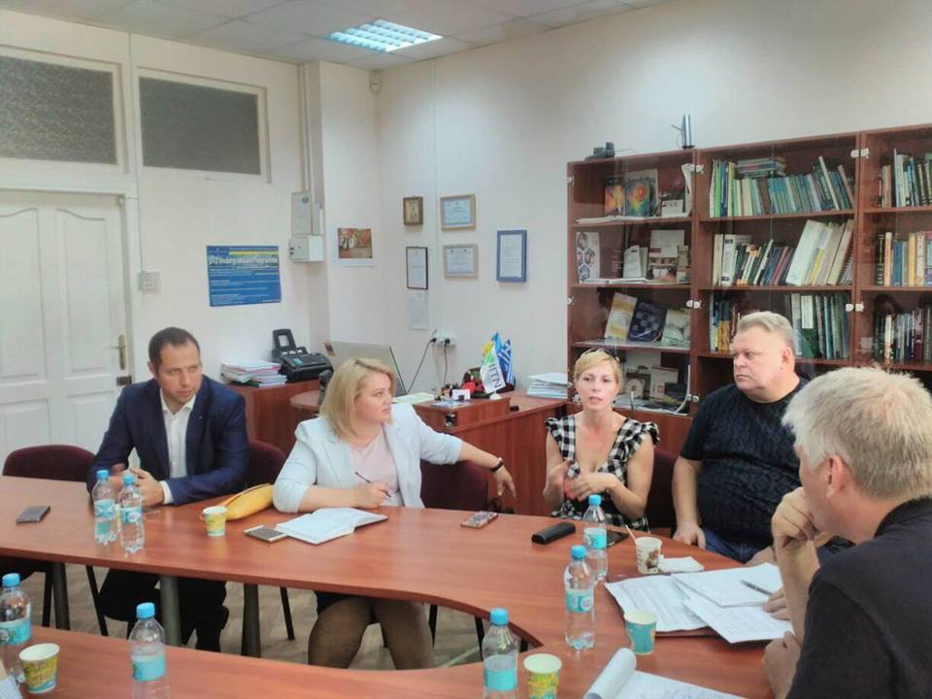
Meeting with employers and alumni: Advisor of the Head of Odesa Regional State Administration Arthur Bredyov & Deputy of the regional council, member of the commission on education Iryna Kovalysh

Slide 9
Meeting with HEI administration (Human Resources, facilities management, library resource centre of the Management program, registrar, exam office, etc.)

Slide 10
Meeting with quality assurance management
Conclusion:
We need to optimize the work with students (goal-setting, motivation, involvement)
It is necessary to accept and approve the missing documents
We need to make public all the documents and recommendations adopted

